Slide 1



VN Habit Tracker
VHT
Supervisor: - Lai Duc Hung
Members: - Luu Thanh Dat - Leader - Pham Thanh Tung

Slide 2
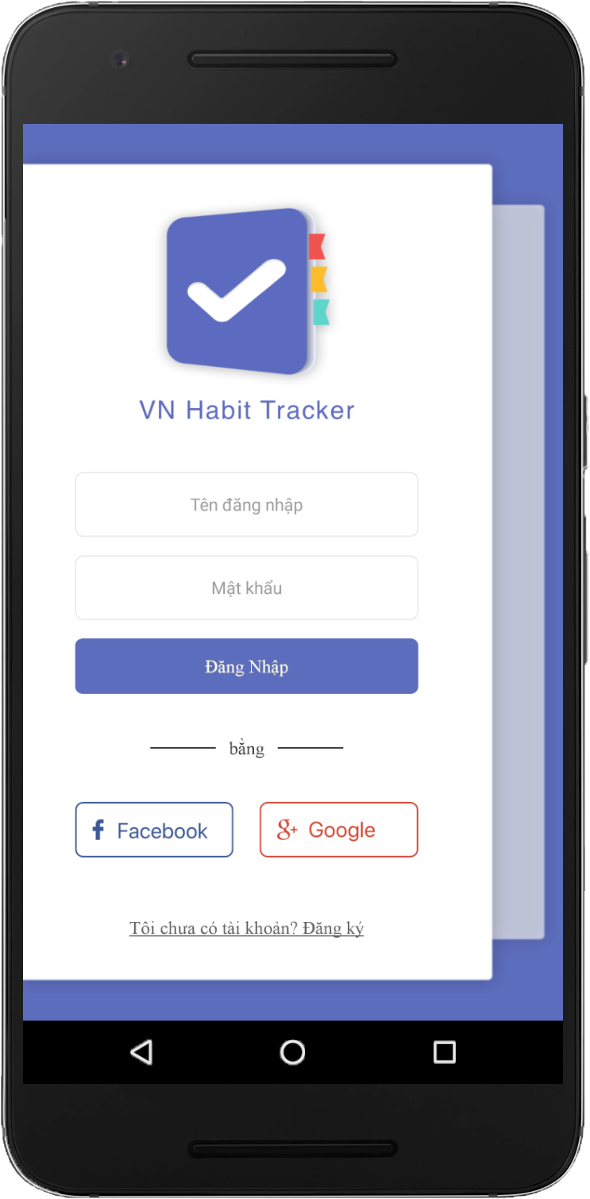

01
Introduction
02
Issues
03
CONTENT
Idea & Solution
04
Outcome
05
Future Plan
06
Q & A
1

Slide 3

1. Introduction
What?
Why?
How?
2

Slide 4



1. Introduction
Children
What?
Why?
How?
3

Slide 5



1. Introduction
Student
What?
Why?
How?
4

Slide 6



1. Introduction
Adult
What?
Why?
How?
5

Slide 7

1. Introduction
What?
Why?
How?
6

Slide 8





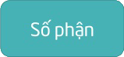
1. Introduction
What?
Why?
How?
7

Slide 9


1. Introduction
What?
Why?
How?
8

Slide 10






2. Issues
z
9

Slide 11

2. Issues
z
10

Slide 12



2. Issues
11

Slide 13
2. Issues
12

Slide 14








2. Issues
13

Slide 15

3. Idea & Solution
What?
Why?
How?
14

Slide 16
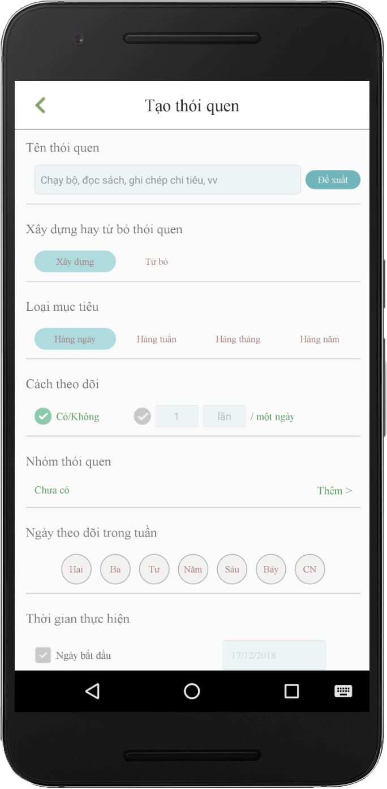

Create Habit
Business Logic
Algorithm
..v..v..
15

Slide 17
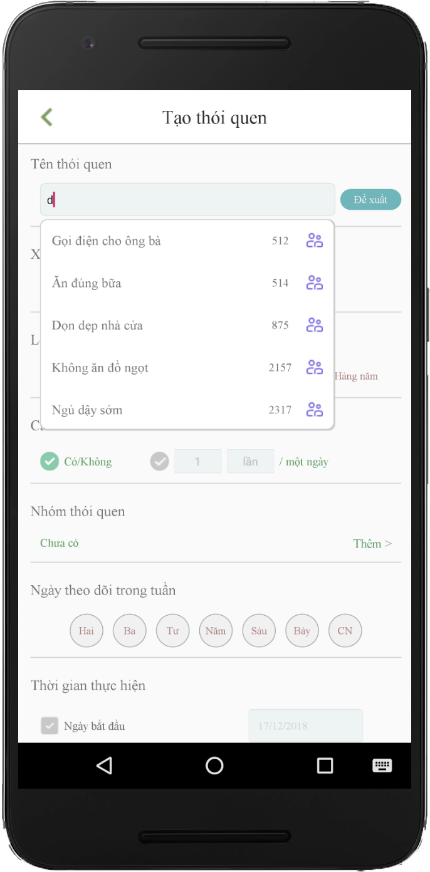
Create Habit
Business Logic
Algorithm
..v..v..
16

Slide 18
Suggest Habit
Business Logic
Algorithm
..v..v..
17

Slide 19
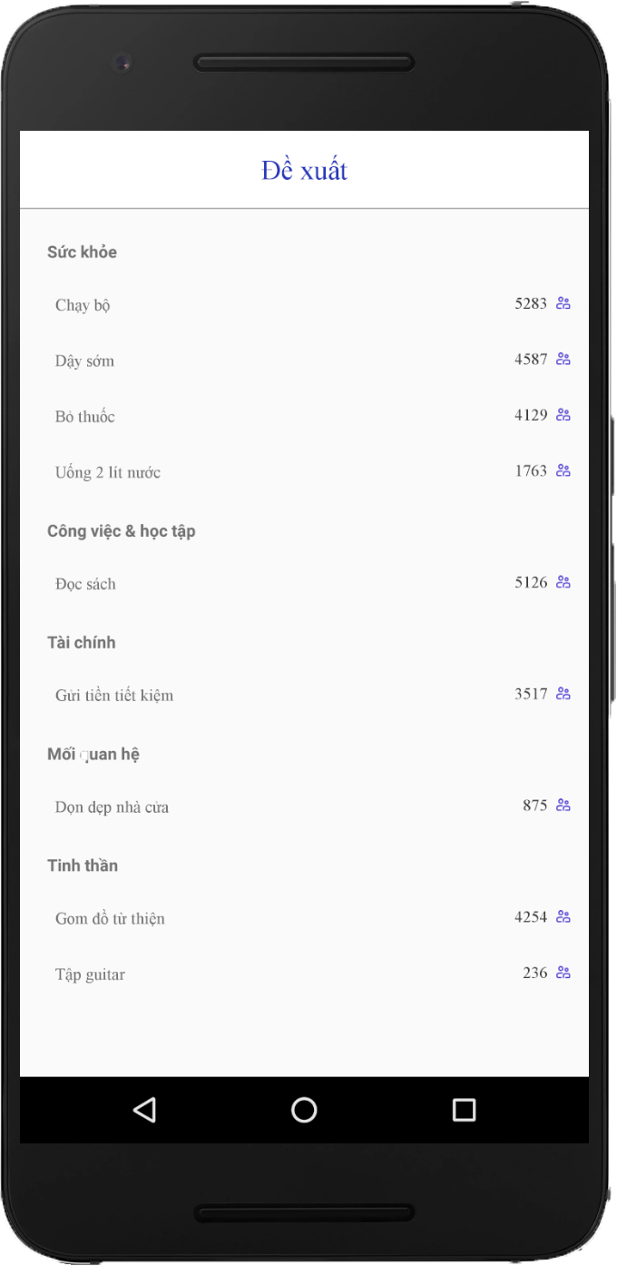
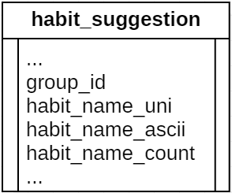
Suggest Habit
compare
have
+ 1
not have
Add New
18

Slide 20
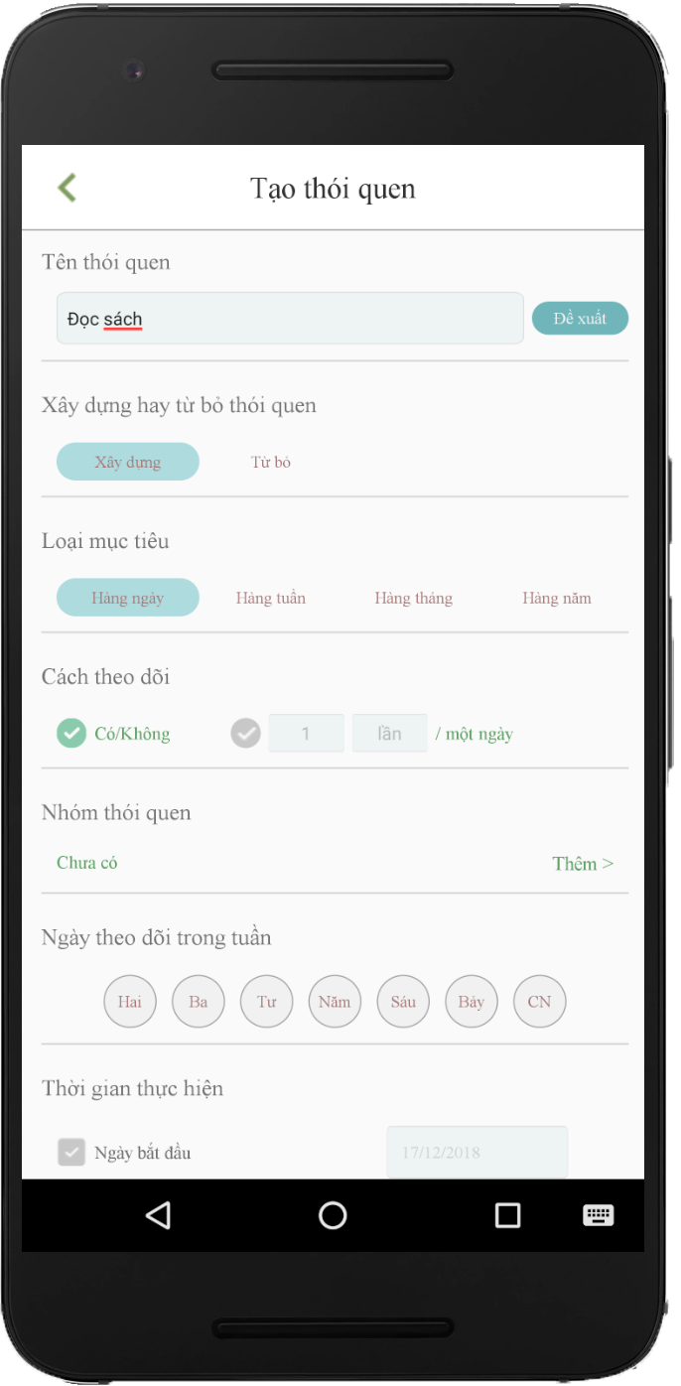
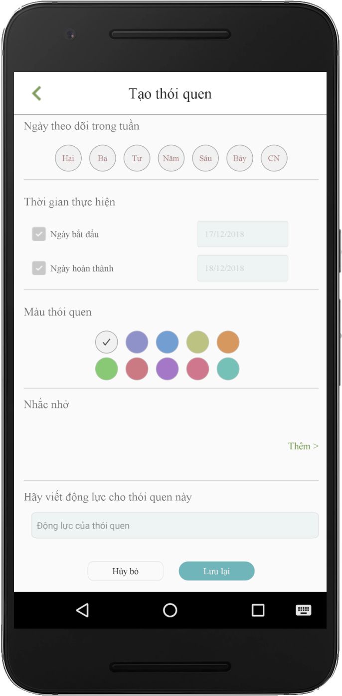
Create Habit
Build/quit
Daily/weekly/monthly/yearly
Yes/no - countable
Group
Day in week
Set time goal
Color
Reminders
Note/ motivation
19

Slide 21

3. Idea & Solution
20

Slide 22

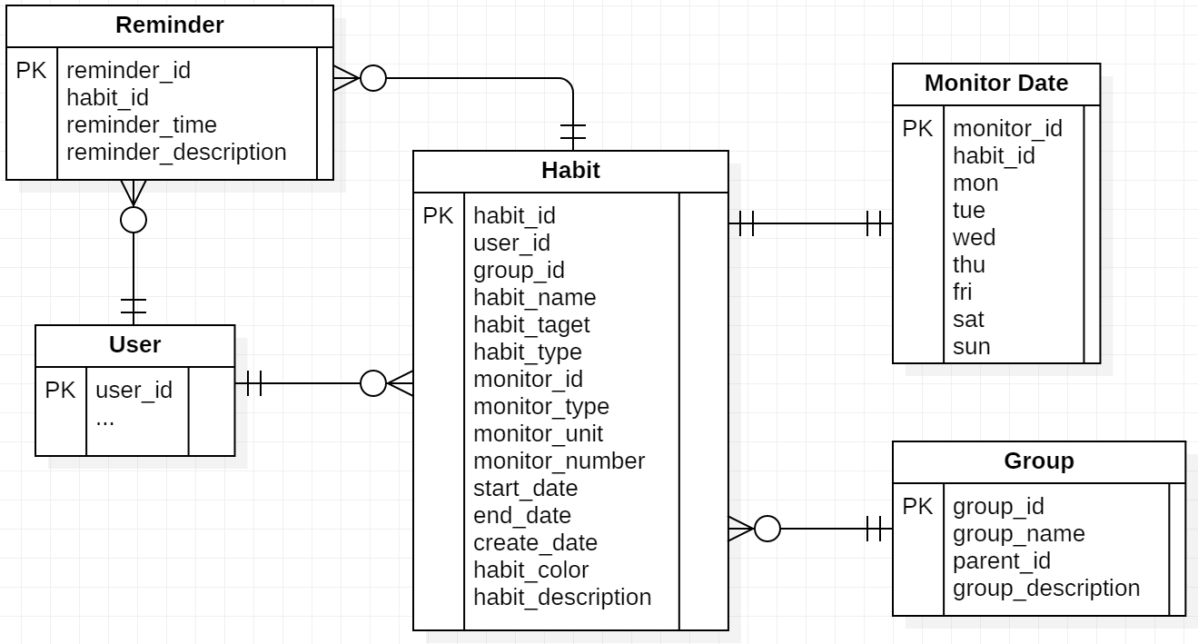
3. Idea & Solution
How?
Habit information
Day in week
Group of habit
Reminder content
21

Slide 23
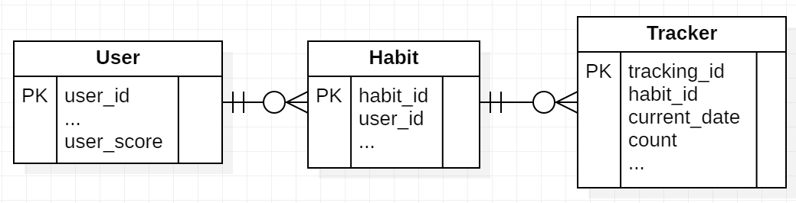
3. Idea & Solution
How?
Tracking Information
Current date
Count
User
User score
22

Slide 24



3. Idea & Solution
$f\left(x\right)=t+d\left(x\right)+c\left(x\right)$ $∀x ∈\{1,2,3\}$
t: input text
d: difficulty of habit
c: level of user
23

Slide 25
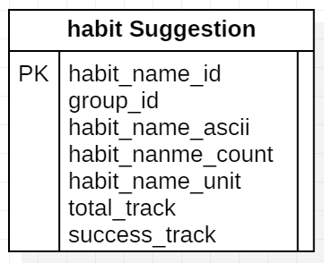
3. Idea & Solution
build/quit
countable
>80%
Success
Daily
Weekly
Monthly
Yearly
yes/no
24

Slide 26
3. Idea & Solution
$f\left(x\right)=t+d\left(x\right)+c\left(x\right)$ $∀x ∈\{1,2,3\}$
25

Slide 27

3. Idea & Solution
Daily
Weekly
Monthly
Yearly
+3
+12
+150
+1
n = 2(n-1) + (n – 2)
+ score
7 days: +2
30 days: +4
60 days: +8
180 days: +18
360 days: +32
Level 1 – 3: easy
Level 4 – 6: medium
Level > 6: hard
26

Slide 28
3. Idea & Solution
$f\left(x\right)=t+d\left(x\right)+c\left(x\right)$ $∀x ∈\{1,2,3\}$
27

Slide 29
3. Idea & Solution
28

Slide 30










4. Outcome
29

Slide 31













5. Future Plan
30

Slide 32



Q & A
31

Slide 33
Thanks for listening!
32

